Slide 1
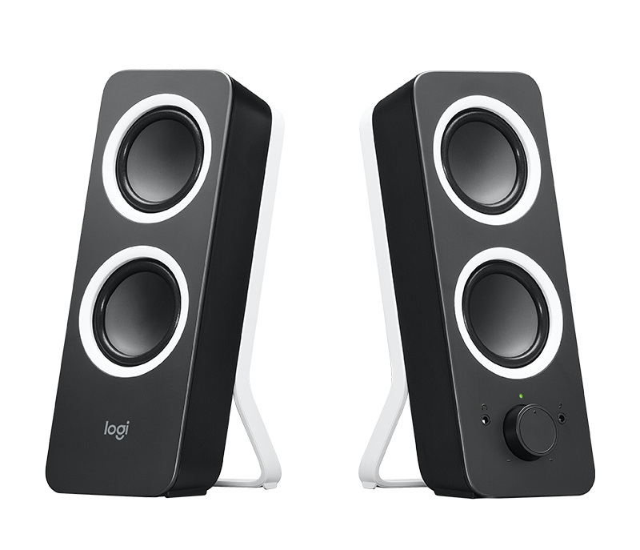
Stereo in the Web Audio API

Slide 2
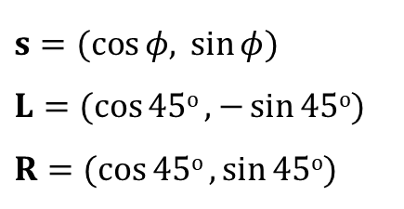
Listener and loudspeakers configuration for placing a sound source using level difference.
x axis
Central listener and two speakers
s
L
φ
R
φ = angle of virtual source
45^{ο} = angle of each speaker
45^{ο}
y axis
$s=(cos{φ, }\sin{φ}$) $L=(cos{\text{45}\text{o}},−\sin{\text{45}\text{o}}$) $R=(cos{\text{45}\text{o}},\sin{\text{45}\text{o}}$)

Slide 3
StereoPannerNode
Stereo panning is implemented with StereoPannerNode
var panNode = context.StereoPanner();
panNode.pan.value = 1;
or
var panNode = new StereoPannerNode(context,{pan:1});
Input is one or two channels
Downmixed if more than two channels
Output is always two channels
Pan parameter ranges from -1 (pan full to the left) to +1 (pan full to the right)
Pan of 0 leaves the audio unchanged

Slide 4
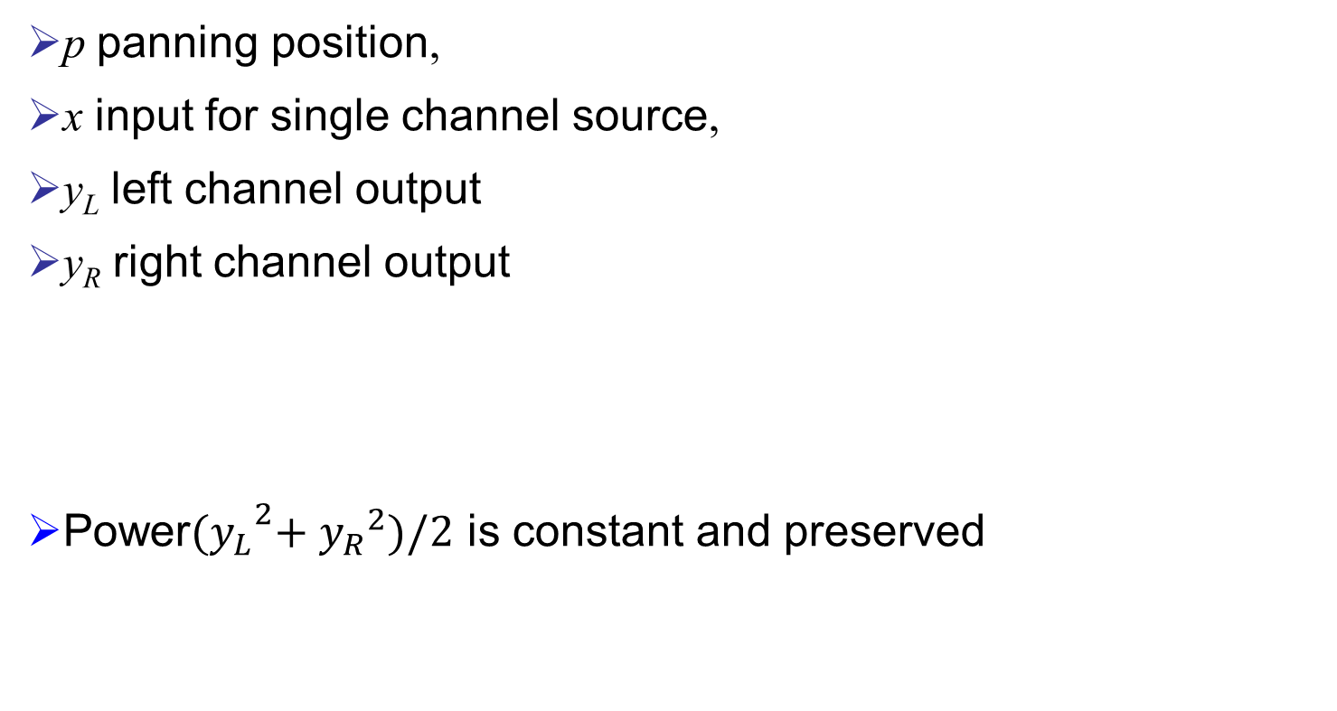
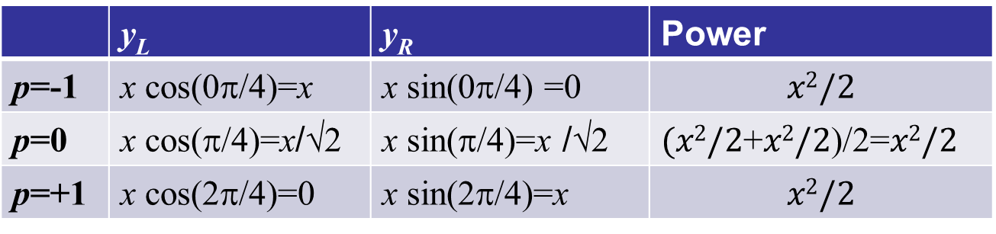
Panning with mono input
p panning position,
x input for single channel source,
y_{L} left channel output
y_{R} right channel output
Power${{(y}_{L}}^{2}+{y_{R}}^{2})/2$ is constant and preserved
y_{L} = x cos((p+1)π/4)
y_{R} = x sin((p+1)π/4)
 | y_{L} | y_{R} | Power
p=-1 | x cos(0π/4)=x | x sin(0π/4) =0 | $$x2/2$$
p=0 | x cos(π/4)=x/√2 | x sin(π/4)=x /√2 | $(x2/2$+$x2/2$)/2=$x2/2$
p=+1 | x cos(2π/4)=0 | x sin(2π/4)=x | $$x2/2$$

Slide 5
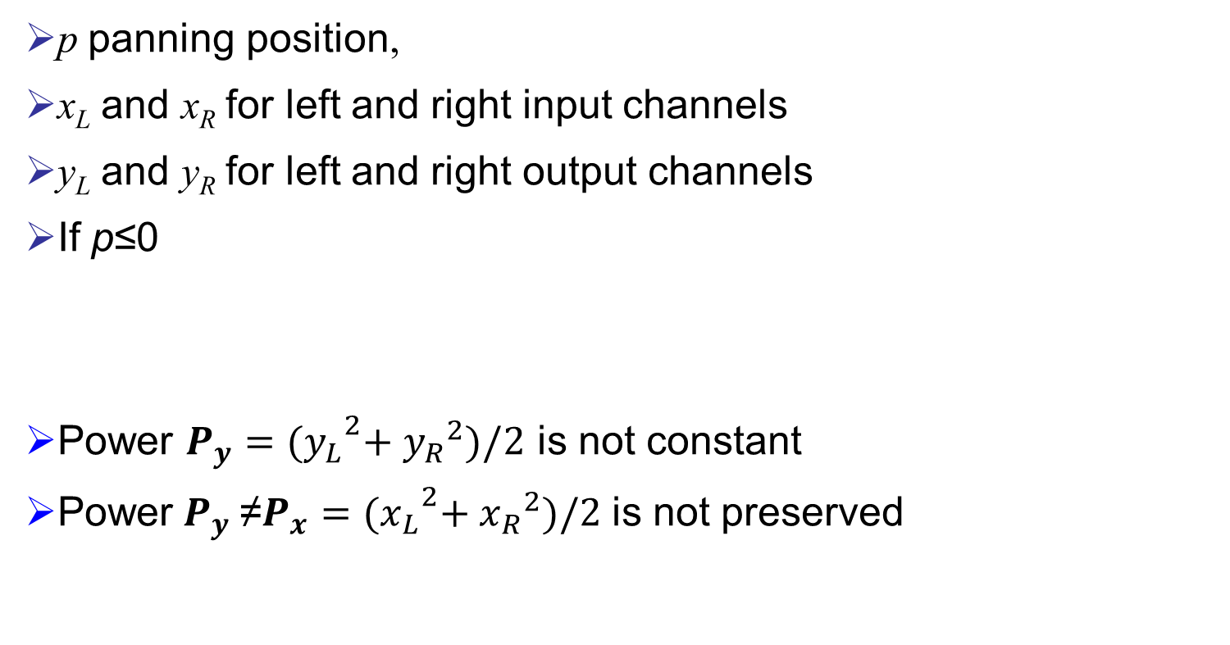
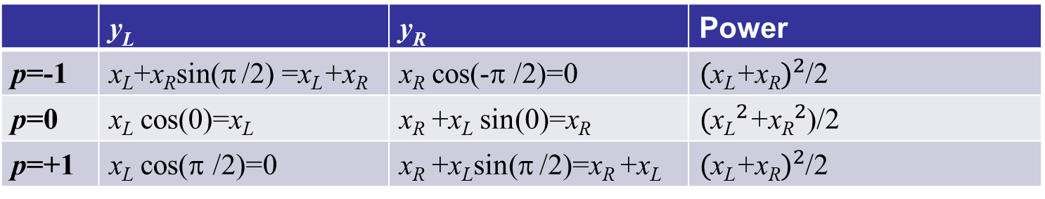
Panning with stereo input
p panning position,
x_{L} and x_{R} for left and right input channels
y_{L} and y_{R} for left and right output channels
If p≤0
Power $P_{y}={{(y}_{L}}^{2}+{y_{R}}^{2})/2$ is not constant
${\text{Power} P}_{y}$≠$P_{x}={{(x}_{L}}^{2}+{x_{R}}^{2})/2$ is not preserved
If p>0
y_{L} = x_{L} + x_{R} sin(|p|π /2)
y_{R} = x_{R} cos(|p|π /2)
y_{L} = x_{L} cos(|p|π /2)
y_{R} = x_{R} +x_{L} sin(|p|π /2)
 | y_{L} | y_{R} | Power
p=-1 | x_{L}+x_{R}sin(π /2) =x_{L}+x_{R} | x_{R} cos(-π /2)=0 | ${\text{(}\text{x}\text{L}\text{+}\text{x}\text{R})}^{2}$/2
p=0 | x_{L} cos(0)=x_{L} | x_{R} +x_{L} sin(0)=x_{R} | $\text{(}{\text{x}\text{L}}^{2}\text{+}{\text{x}\text{R}}^{2}$)/2
p=+1 | x_{L} cos(π /2)=0 | x_{R} +x_{L}sin(π /2)=x_{R} +x_{L} | ${\text{(}\text{x}\text{L}\text{+}\text{x}\text{R})}^{2}$/2

Slide 6
Panning moves a stereo source
Initial panning positions
Pan to the left
Pan to the right

